Slide 1
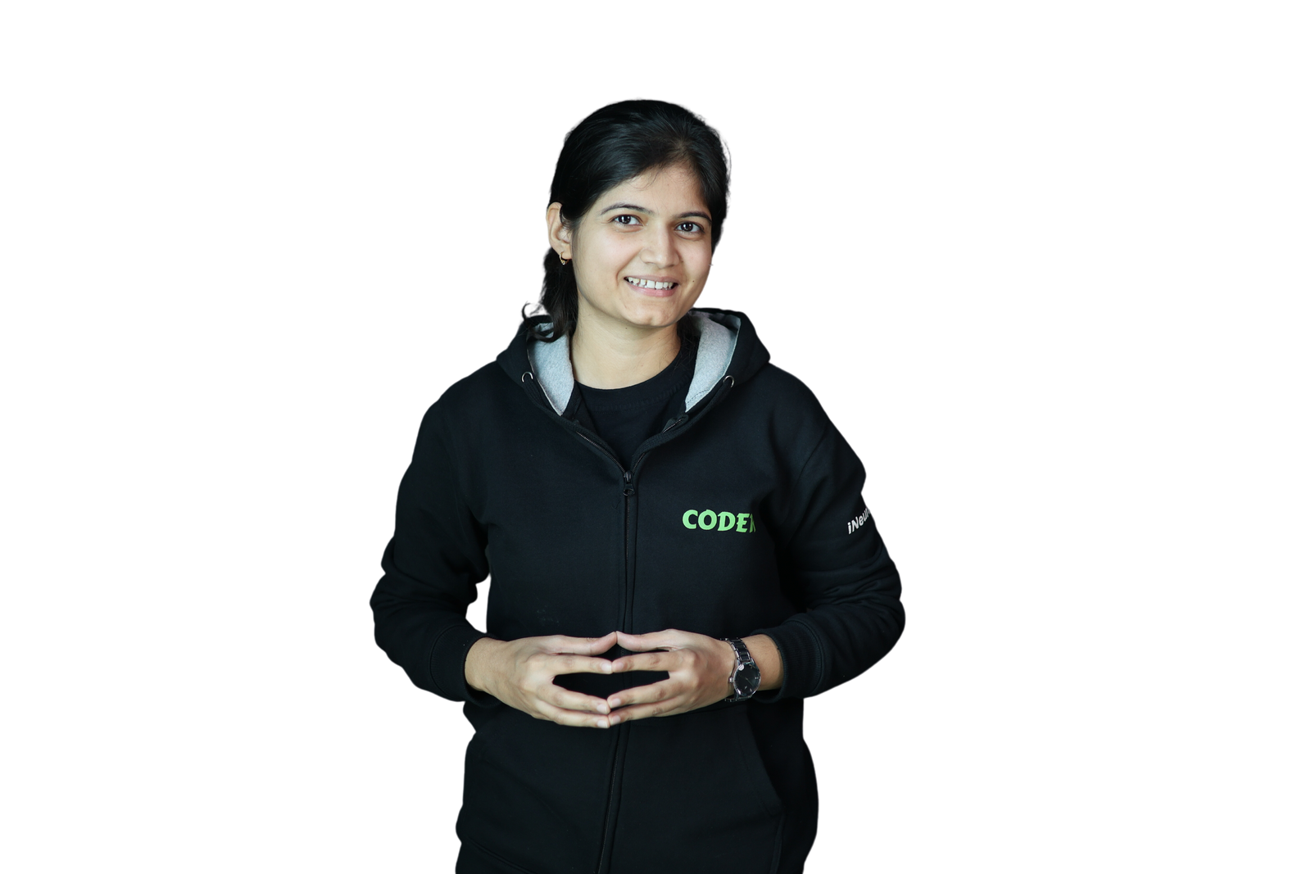



Maximizing Your Potential:
How to Utilize LinkedIn for Career Development
by
Priya Bhatia
Data Scientist, Mentor and YouTuber
https://www.linkedin.com/in/bhatia-priya/
https://github.com/priya6971
https://www.youtube.com/c/PriyaBhatia/

Slide 2
What is LinkedIn?
Social networking platform mainly focuses on professional networking
Major focuses on LinkedIn Profile:
Profile Picture
Background photo
Headline under your name
About
Customized URL
Adding your skillset
Experience Section
Education
Recommendations

Slide 3
Thank you !
https://www.linkedin.com/in/bhatia-priya/
https://github.com/priya6971
https://www.youtube.com/c/PriyaBhatia/
Queries?

